Slide 1
PSCS385-Development of AI/ML based solution for detection of face-swap based deep fake videos
PIP4004 University Project
Review-3
Batch Number: CIT-G25
Roll Number 20211CIT0133 20211CIT0134 | Student Name MANISH RANJAN M B
20211CIT0010 | JAMPULA VISHNU VARDHAN
20211CIT0030 | SHREEJIT S SHETTY
20211CIT0138 | Harsha Vardhan P
Under the Supervision of,
Dr. Mohana SD
Professor / Associate Professor / Assistant Professor
School of Computer Science and Engineering
Presidency University
Name of the Program: Btech
Name of the HoD: Dr. S P Ananda Raj
Name of the Program Project Coordinator: Dr.Sharmasth Vali Y
Name of the School Project Coordinators: Dr. Sampath A K / Dr. Abdul Khadar A / Mr. Md Ziaur Rahman

Slide 2
Abstract
The rise of deep fake technology, particularly face-swap videos, has raised significant concerns regarding the spread of misinformation and the invasion of privacy. These highly realistic forgeries pose a challenge to current detection methods, which often fail to accurately identify them. This project aims to address this issue by developing a straightforward and effective AI/ML-based solution to detect face-swap deep fake videos. By analyzing visual and auditory inconsistencies, such as mismatches in facial movements, lighting, and audio-visual synchronization, the proposed system seeks to enhance the accuracy and reliability of deep fake detection. The ultimate goal is to provide a robust tool that can be deployed to mitigate the harmful effects of deep fakes, thereby safeguarding digital integrity and privacy.

Slide 3
Literature Survey :
Here’s a literature survey based on the papers that we have researched:
1. This paper likely explores advanced techniques for detecting deepfakes, focusing on the challenges posed by increasingly realistic synthetic media.
2. This paper probably investigates the role of deep learning architectures, such as convolutional neural networks (CNNs), in detecting deepfakes.
3. This research likely focuses on the ethical and societal implications of deepfake technology, alongside technical detection methods. It may propose a multi-modal approach that combines visual, auditory, and behavioral cues to improve detection rates.
4. This paper might present a comparative analysis of existing deepfake detection techniques, highlighting their strengths and weaknesses. It could introduce a hybrid model that integrates traditional image processing methods with deep learning to enhance detection performance. The study may also emphasize the need for robust datasets to train and test detection systems.
5. This research likely explores the use of generative adversarial networks (GANs) in creating and detecting deepfakes. It may propose a GAN-based detection system that identifies inconsistencies in synthetic media by analyzing pixel-level details. The paper could also discuss the adversarial nature of deepfake creation and detection.

Slide 4
6. This paper probably focuses on the role of audio-visual synchronization in deepfake detection. It may propose a method to analyze mismatches between lip movements and speech patterns to identify fake videos. The study could also highlight the importance of multi-modal approaches in improving detection accuracy.
7. This research likely addresses the challenges of detecting deepfakes in low-quality or compressed videos. It may propose a lightweight detection model that can operate efficiently on resource-constrained devices. The paper could also discuss the trade-offs between detection accuracy and computational complexity.
8. This paper might explore the use of explainable AI (XAI) techniques in deepfake detection. It may propose a model that not only detects deepfakes but also provides interpretable insights into the decision-making process. The study could emphasize the importance of transparency in building trust in detection systems.
9. This research likely investigates the role of temporal analysis in detecting deepfakes. It may propose a method that analyzes frame-by-frame inconsistencies in videos to identify synthetic content. The paper could also discuss the challenges of detecting deepfakes in real-time streaming applications.
10. This paper probably focuses on the use of transfer learning in deepfake detection. It may propose a pre-trained model that can be fine-tuned for specific datasets or scenarios. The study could also highlight the benefits of transfer learning in reducing the need for large annotated datasets.

Slide 5
Objectives :
1. Develop an AI/ML-Based Deepfake Detection System
Objective: Build a robust and accurate deepfake detection system using the Deepware Scanner API to analyze uploaded videos and determine their authenticity.
2. Create a User-Friendly Mobile Application
Objective: Design and develop a cross-platform mobile app (Android) with an intuitive user interface for seamless video upload, analysis, and result visualization.
3. Implement Secure User Authentication
Objective: Integrate Firebase Authentication to provide secure login and signup functionality for users.
4. Support Multiple Video Formats
Objective: Enable the app to accept and process all video formats (e.g., MP4, AVI, MOV) for deepfake detection.
5. Provide Detailed Analysis and Visualization
Objective: Display the results of deepfake detection in a user-friendly format, including confidence scores, graphs, and visualizations.

Slide 6
6. Integrate Cloud Storage for Video Management
Objective: Use Cloudinary as an alternative to Firebase Storage for uploading, storing, and managing user videos.
7. Ensure Cost-Effective Development
Objective: Utilize free and open-source tools (e.g., React Native, Firebase, Cloudinary) to build the app without incurring significant costs.
8. Deploy the App on Google Play Store
Objective: Prepare the app for deployment on the Google Play Store by generating a signed APK and following Play Store guidelines.
9. Ensure Scalability and Future Enhancements
Objective: Design the app with a modular architecture to allow for future updates, such as adding new detection models or features.
10. Educate Users About Deepfake Technology
Objective: Include educational content in the app (e.g., FAQs, tutorials) to raise awareness about deepfakes and their potential impact.

Slide 7
Existing Methods & their Drawbacks :
1. Spatial Artifacts Analysis
Method: This approach examines individual frames of a video for inconsistencies or artifacts that are common in deepfakes but not in real videos. This can include:
Inconsistencies in facial regions (blurring, warping).
Noise patterns that don't match the rest of the frame.
Lack of fine details (e.g., in hair or skin texture).
Drawback: Deepfake technology is constantly improving. Newer deepfakes can generate very realistic images, reducing or eliminating these obvious spatial artifacts. This method can be easily fooled by high-resolution deepfakes or those with post-processing to smooth out artifacts.
2. Temporal Inconsistencies
Method: This method focuses on the motion and changes between frames in a video. Deepfakes may have issues with:
Unnatural or jerky movements.
Discontinuities in lighting or color between frames.
Lack of realistic blinking or other subtle facial movements.
Drawback: Some deepfake methods are getting better at generating more temporally coherent videos. Additionally, video compression can introduce its own artifacts, making it difficult to distinguish between compression artifacts and deepfake artifacts.

Slide 8
3. Facial Landmark Analysis
Method: This technique involves detecting and tracking facial landmarks (eyes, nose, mouth) throughout a video. It then analyzes:
The movement and relationships between these landmarks.
Whether the movements are physically plausible.
Consistency of facial structure.
Drawback: This method is heavily reliant on accurate facial landmark detection. If the deepfake has manipulated the face significantly or if the video quality is poor, landmark detection can fail, leading to inaccurate analysis. It might also struggle with profile views or occluded faces.
4. Blood Flow and Skin Texture Analysis
Method: Some advanced techniques attempt to analyze more subtle cues, such as:
Micro-expressions and subtle changes in skin texture.
Patterns of blood flow under the skin (which are often not accurately replicated in deepfakes).
Drawback: These methods are often highly complex and require very high-resolution video and specialized sensors or analysis techniques. They may not be practical for real-time detection or for use with typical consumer-grade video.

Slide 9
Proposed Methodologies :
1. Video Processing
Frame Extraction:
Utilize OpenCV to accurately extract frames from uploaded videos.
Ensure consistent frame sampling to maintain temporal information.
Face Detection:
Employ the face_recognition library for robust face detection.
Crop faces with padding to provide context for the model.
2. Deepfake Detection Model
Model Architecture:
Use a ResNeXt-50 backbone with an LSTM for sequence analysis.
This architecture captures both spatial and temporal features.
Prediction Mechanism:
Apply Softmax to the model's output to obtain confidence scores.
Return both the binary prediction (REAL/FAKE) and confidence level.

Slide 10
Proposed Methodologies :
3. User Authentication
Firebase Authentication:
Leverage Firebase for secure and reliable user authentication.
Handle user registration and login processes.
Firestore Integration:
Store user data, including hashed passwords, in Firestore.
Use Django's check_password to verify passwords against stored hashes.
4. Result Visualization
Pie Chart Representation:
Visualize prediction confidence using a clear pie chart.
Use distinct colors to differentiate between REAL and FAKE predictions.
Image Display:
Showcase preprocessed frames and cropped faces to aid in interpretation.
Provide visual context for the model's analysis.

Slide 11
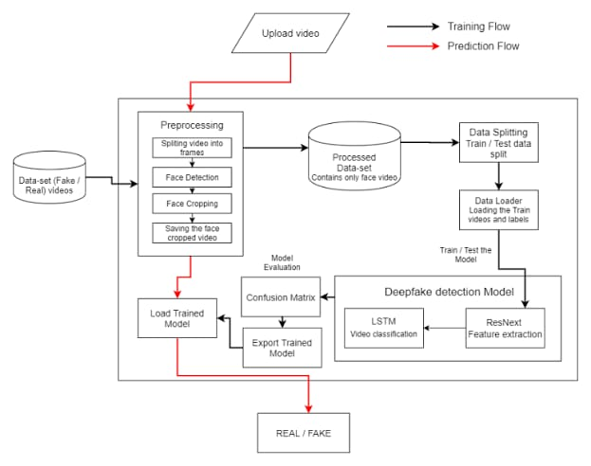
Architecture Diagram :

Slide 12
Hardware and Software Details :
Hardware requirements
GPU: NVIDIA RTX 30XX series or higher (e.g., RTX 3090, A100)
CPU: Intel i7/i9 or AMD Ryzen 7/9 series.
RAM: 32GB or more.
Storage: SSD (1TB+), optional external storage (4TB+)
Networking: High-speed internet (for cloud computing)
Software Requirements
Operating System: Linux (Ubuntu 20.04+) or Windows 10/11
Deep Learning Frameworks: Tensor Flow or PyTorch
Libraries: OpenCV (video processing),librosa (audio processing),Hugging Face Transformers (for temporal analysis),Scikit-learn (evaluation, metrics),NumPy & Pandas (data handling)
Self-Supervised Learning Libraries: SimCLR or BYOL
Data Augmentation/Pre processing: Albumentations, Speech-to-Text API
GANs: CycleGAN, StyleGAN, custom GAN implementations
Deployment: Flask/ FastAPI, Dockers
Visualization: Tensor Board, Visdom, Matplotlib, Seaborn

Slide 13
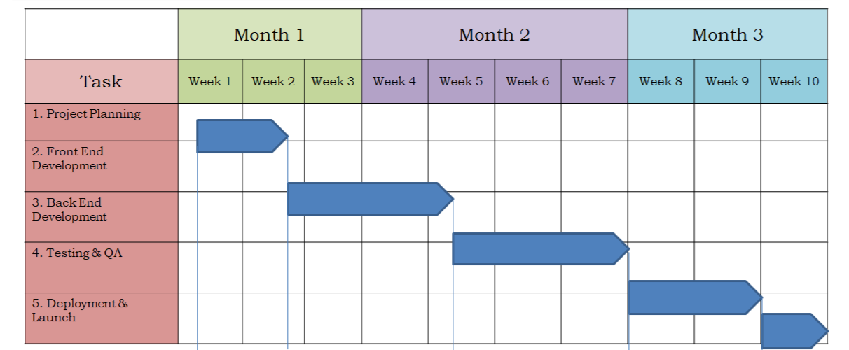
Timeline of the Project (Gantt Chart)

Slide 14
References (IEEE Paper format)
[1] Deepak Dagar; Dinesh Kumar Vishwakarma ,A Diverse Manipulation Deepfake Video Dataset, 2020
[2]Anis Trabelsi; Marc Michel Pic; Jean-Luc Dugelay,Improving Deepfake Detection by Mixing Top Solutions of the DFDC ,2019
[3]Jixin Zhang; Ke Cheng; Giuliano Sovernigo; Xiaodong Lin, A Heterogeneous Feature Ensemble Learning based Deepfake Detection Method,2022
[4]Shan Jia; Xin Li; Siwei Lyu, Model Attribution of Face-Swap Deepfake Videos,2021
[5]Siddharth Yadav; Sahithi Bommareddy; Dinesh Kumar Vishwakarma, Robust and Generalized DeepFake Detection,2020
[6]Qasim Jaleel; Israa Hadi Ali, Facial Behavior Analysis-Based Deepfake Video Detection using GAN Discriminator,2022
[7]Sio Jurnalis Pipin; Ronsen Purba; Muhammad Fermi Pasha, Deepfake Video Detection Using Spatiotemporal Convolutional Network and Photo Response Non Uniformity,2021
[8]Reva Chinchalkar; Rachita Sinha; Manish Kumar; Neeraj Chauhan; Shubhangi Deokar; Sudhanshu Gonge, Detecting Deepfakes using CNN and LSTM,2022
[9]Lalitha S; Kavitha Sooda, DeepFake Detection Through Key Video Frame Extraction using GAN,2021

Slide 15


